Slide 1


PMA AMBASSADORS
FEEDBACK WANTED
TO IMPROVE
PERFORMANCE.GOV.
June 16, 2023 | Ivan Metzger, GSA, Office of Government-wide Policy..

Slide 2

BACKGROUND
—
Government Performance and Results Act
Information made available on the website . . . shall be readily accessible and easily found . . . [and] provided in a way that presents a coherent picture of all Federal programs, and the performance of the Federal Government as well as individual agencies.

Slide 3
Performance.gov
Helping the American public–especially civil society professionals and Federal employees–track the progress of U.S. strategic goals and opportunities to contribute

Slide 4

Vision
A digital platform that serves as a U.S. strategic asset
Performance.gov
Helping the American public–especially civil society professionals and Federal employees–track the progress of U.S. strategic goals and opportunities to contribute

Slide 5
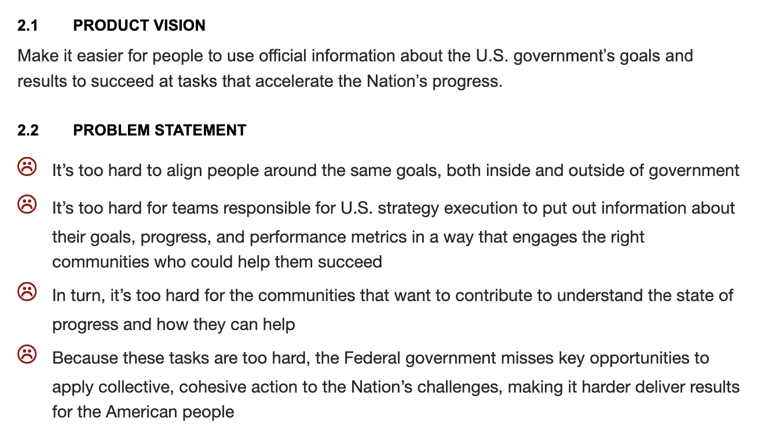

Slide 6
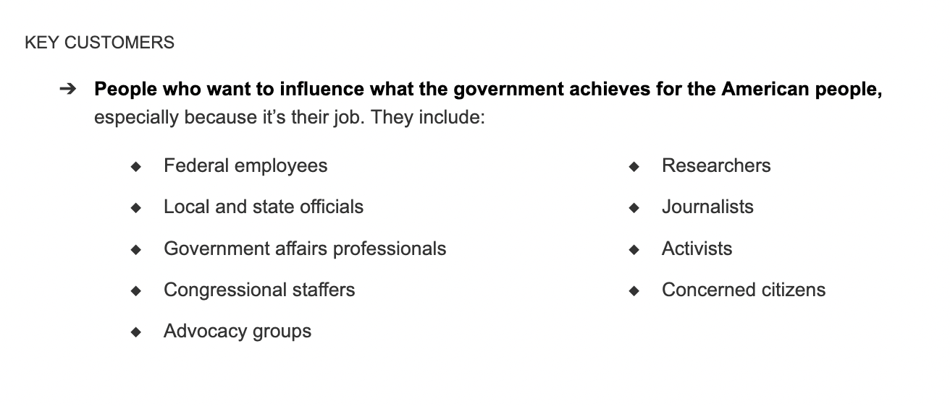

Slide 7
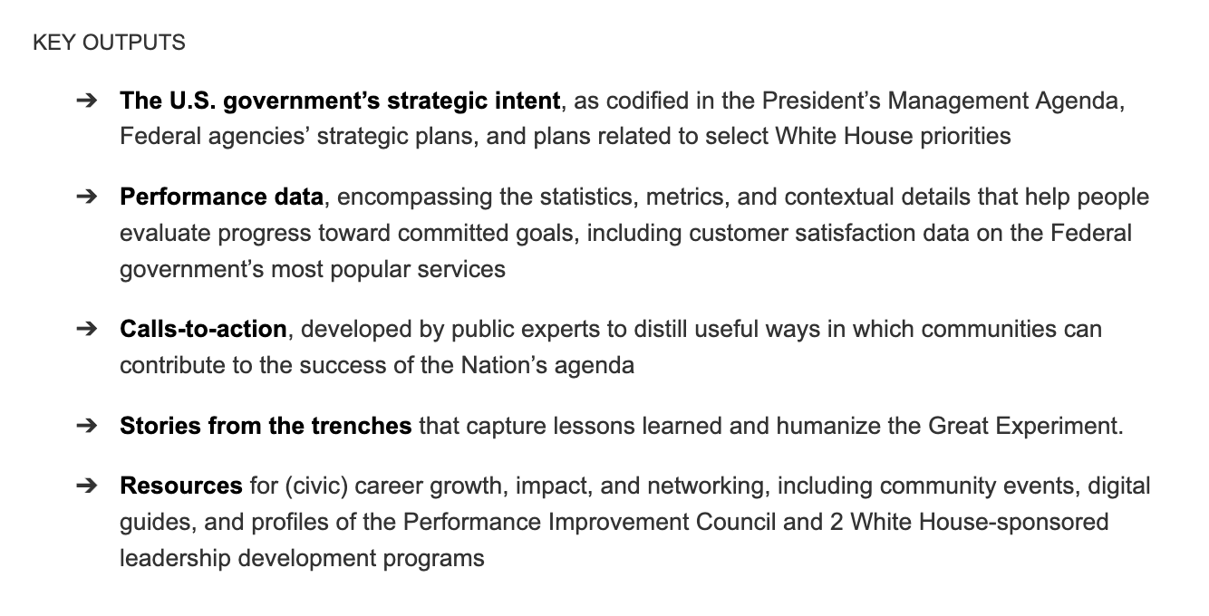

Slide 8
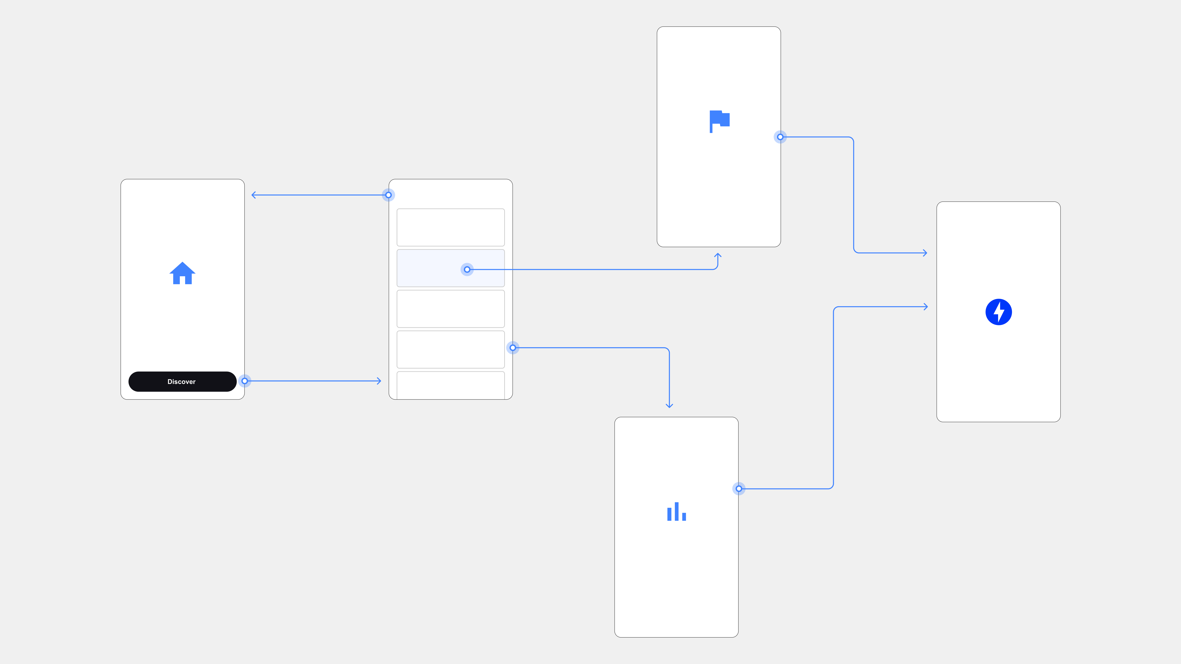
Key User Flow
USER FLOW
User visits site
SEARCH BY THE ISSUES YOU MANAGE

Slide 9
Key User Flow
USER FLOW
Searches based on issues they manage
SEARCH BY THE ISSUES YOU MANAGE

Slide 10
Key User Flow
USER FLOW
SEARCH BY THE ISSUES YOU MANAGE
Finds a relevant goal or metric and learns more

Slide 11
Key User Flow
USER FLOW
Clicks a call-to-action defined
by goal team
SEARCH BY THE ISSUES YOU MANAGE

Slide 12



THEORY OF CHANGE
More strategic visibility throughout the civic ecosystem
More strategic visibility throughout the civic ecosystem
More collective, cohesive action from people who can help you succeed
More strategic progress—what it’s all about

Slide 13

THEORY OF CHANGE
More strategic visibility throughout the civic ecosystem
More collective, cohesive action from people who can help you succeed
More strategic progress—what it’s all about

Slide 14
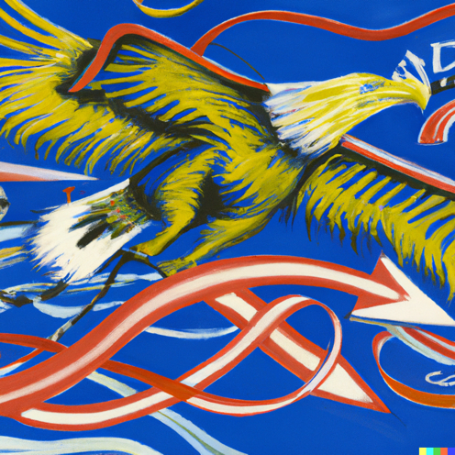
THEORY OF CHANGE
More strategic visibility throughout the civic ecosystem
More collective, cohesive action from people who can help you succeed
More strategic progress—what it’s all about

Slide 15
“
The greatest asset in any knowledge-based organization is the expertise of its professionals—the engineers and architects at a design-build firm, the scientists at a research institute, the lawyers and accountants at their respective firms, and so on. The most important challenge faced by any such organization is bringing that collective expertise to bear on problems that, increasingly, are so complicated and so sophisticated that no single expert—no matter how smart or hardworking—is in a position to solve them. Today’s problems simply demand that specialists . . . work together to integrate their separate knowledge bases and skill sets to forge coherent, unified solutions. They have to collaborate, in efficient and effective ways. Gardner, H. K. (2016). Smart collaboration: How professionals and their firms succeed by breaking down silos. Harvard Business Review Press.
What we want to help solve

Slide 16

Where we want your feedback today

Slide 17
Key User Flow
USER FLOW
How you want to search the
U.S. strategic portfolio
SEARCH BY THE ISSUES YOU MANAGE

Slide 18
GUIDELINES
Be candid
Be specific
Tie everything to goals
Affirm what’s working
Problems first, then solutions
Suggestions, not mandates
Have fun!

Slide 19
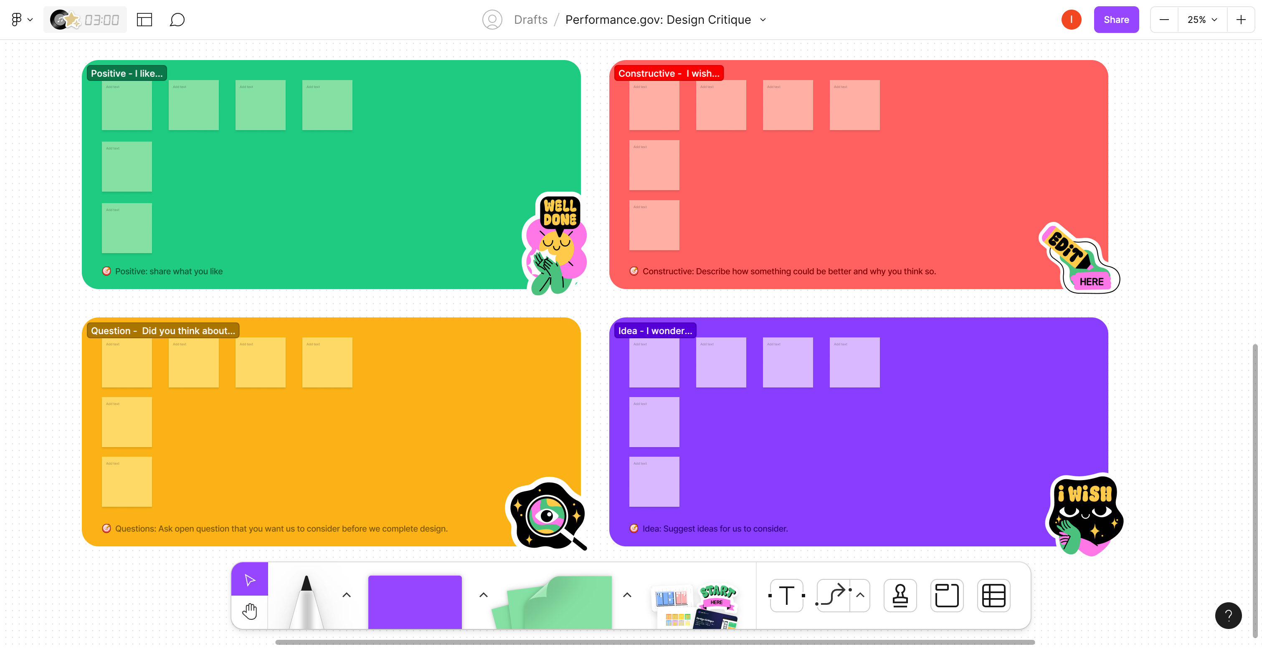
We’ll be using Figjam to facilitate
Link: https://www.figma.com/file/btI8ZODb3Zl4pMM9NdVczk/Performance.gov%3A-Design-Critique?type=whiteboard&node-id=0%3A1&t=Rr0gOZKE4ja4rGOE-1

